Slide 1

Data on the Inside versus
Data on the Outside
Pat Helland
Architect
Microsoft Corporation

Slide 2

Outline
Introduction
Data: Then and Now
Data on the Outside
Data on the Inside
Representations of Data
Conclusion

Slide 3
Outline
Introduction
Data: Then and Now
Data on the Outside
Data on the Inside
Representations of Data
Conclusion

Slide 4

Service Oriented Architectures
Actually, we’ve been
doing this for years!
We’re just been
making it more pervasive…
Service-Orientation
  Independent Services
    Chunks of Code and Data
  Interconnected via Messaging
Services Communicate with Messages
  Nothing Else
  No Other Knowledge about Partner
    May Be Heterogeneous
Service-A
Service-B
Notes:
The key thing about a service oriented architecture is that services only communicate with messages
There is no other interaction besides messages
You can’t tell anything about the other machine except what messages it sends
It does not have to be the same type of system…

Slide 5
Bounding Trust via Encapsulation
Services Only Do Limited Things for Their Partners
  This Is How They Bound Their Trust
Encapsulation Is About Bounding Trust
  Business Logic Ensures Only the Desired Operations Happen
  No Changes to the Data Occur Except Through Locally Controlled Business Logic!
Service
Things I’ll Do for Outsiders
Deposit
Withdrawal
Transfer
Account Balance Check

Slide 6
Encapsulating Both Change and Reads
Encapsulating Change
  Ensures Integrity of the Service’s Work
  Ensures Integrity of the Service’s Data
Encapsulating Exported Data for Read
  Ensures Privacy by Controlling What’s Exported
  Allows Planning for Loose Coupling and Expirations
    E.g. Wednesday’s Price-List
Sanitized Data
for Export
Data
Exported Data
Private
Internal
Data
Business Request

Slide 7
Trust and Transactions
For This Talk, Services Do Not Share Transactions!
  This Ends Up Being a Definitional (Terminology) Issue
  Clearly Some Bodies of Code Are Distrusting of Each Other
    Those Bodies of Code Will Not Hold Locks for the Partner
  Services With Intermittent Connectivity Won’t Do 2-Phase Commit
We Are Considering the Implications of These Cases
  The Word Service Is Being Used for Not Sharing Transactions!
Service-A
Service-B
Atomic “ACID” Transaction

Slide 8
Data Inside and Outside Services
Data Is Different Inside from Outside
Outside the Service
  Passed in Messages
  Understood by Sender and Receiver
  Independent Schema Definition Important
  Extensibility Important
Inside the Service
  Private to Service
  Encapsulated by
  Service Code
MSG
Data
SQL
MSG
Data Outside
the Service
Data Inside
the Service
Notes:
Data lives either:
Outside services
Passed in messages
Must be understood by both:
The service creating the “inter-service-data”, and
The service reading and using the “inter-service-data”
Inside a single service
Private to the service and only accessed via encapsulating code
May be a replica of some data that lives outside services
The characteristics of the “inside” data differ from the “outside” data
Inside, you need tightly organized schema associated with you application code
You may want to apply business intelligence to it
You may need to adjust your schema for semantic changes or for optimization of your application’s database access
Outside, you need to optimize for flexibility, extensibility, and mutual understanding across systems
This should tolerate changes across time and the evolution of the participating services

Slide 9
Operators and Operands
Messages Contain Operators
  Requests a Business Operation
  Operators Provide Business Semantics
  Part of the Contract between the Two Services
Operator Messages Contain Operands
  Details Needed To Do the Business Operation
  The Sending Service Must Put Them into the Message
Service
Deposit
Operands
Operator

Slide 10
Outline
Introduction
Data: Then and Now
Data on the Outside
Data on the Inside
Representations of Data
Conclusion

Slide 11
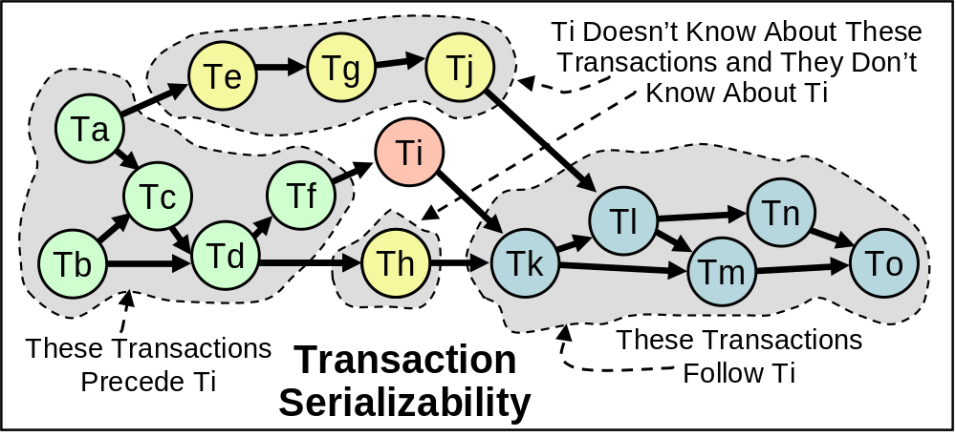
Transactions and Inside Data
Transactions Make You Feel Alone
  No One Else Manipulates the Data When You Are
Transactional Serializability
  The Behavior Is As If a Serial Order Exists

Slide 12
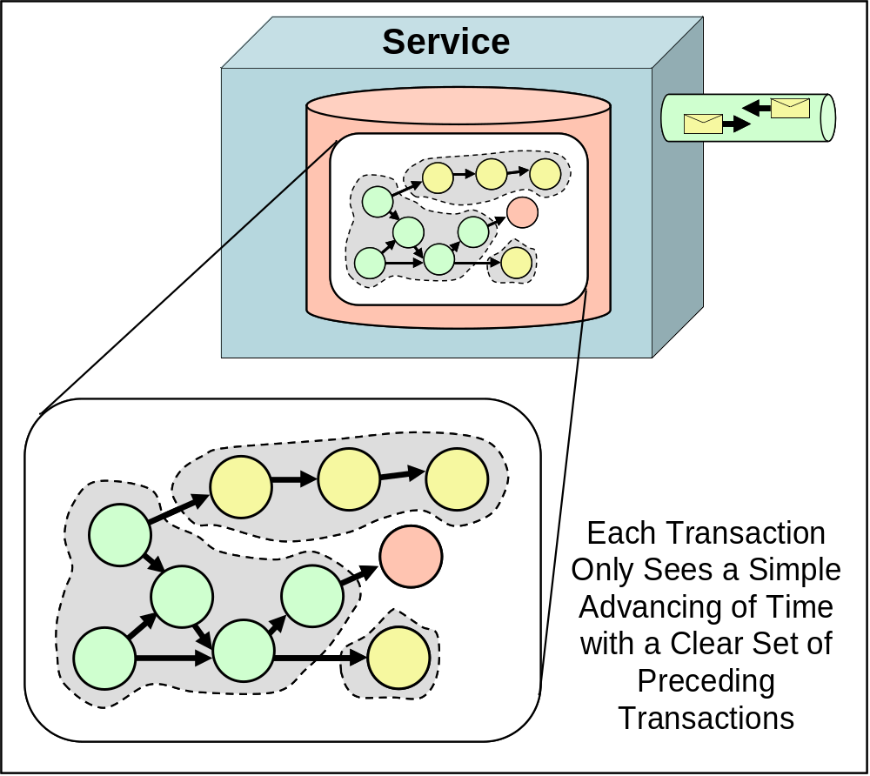
Life in the “Now”
Transactions Live in the “Now” Inside Services
  Time Marches Forward
  Transactions Commit
  Advancing Time
  Transactions See
  the Committed
  Transactions
A Service’s
Biz-Logic Lives
in the “Now”

Slide 13
Sending Unlocked Data Isn’t “Now”
Messages Contain Unlocked Data
  Assume No Shared Transactions
Unlocked Data May Change
  Unlocking It Allows Change
Messages Are Not From the “Now”
  They Are From the Past
There Is No Simultaneity At a Distance!
  Similar to Speed of Light
  Knowledge Travels at Speed of Light
  By the Time You See a Distant Object It May Have Changed!
  By the Time You See a Message, the Data May Have Changed!
Services, Transactions, and Locks Bound Simultaneity!
  Inside a Transaction, Things Appear Simultaneous (to Others)
  Simultaneity Only Inside a Transaction!
  Simultaneity Only Inside a Service!

Slide 14
Outside Data: a Blast from the Past
All Data From Distant Stars Is From the Past
  10 Light Years Away; 10 Year Old Knowledge
  The Sun May Have Blown Up 5 Minutes Ago
    We Won’t Know for 3 Minutes More…
All Data Seen From a Distant Service Is From the “Past”
  By the Time You See It, It Has Been Unlocked and May Change
Each Service Has Its Own Perspective
  Inside Data Is “Now”; Outside Data Is “Past”
  My Inside Is Not Your Inside; My Outside Is Not Your Outside
Going to SOA Is Like Going From Newtonian to Einstonian Physics
  Newton’s Time Marched Forward Uniformly
    Instant Knowledge
  Before SOA, Distributed Computing Many Systems Look Like One
    RPC, 2-Phase Commit, Remote Method Calls…
  In Einstein’s World, Everything Is “Relative” To One’s Perspective
  SOA Has “Now” Inside and the “Past” Arriving in Messages

Slide 15
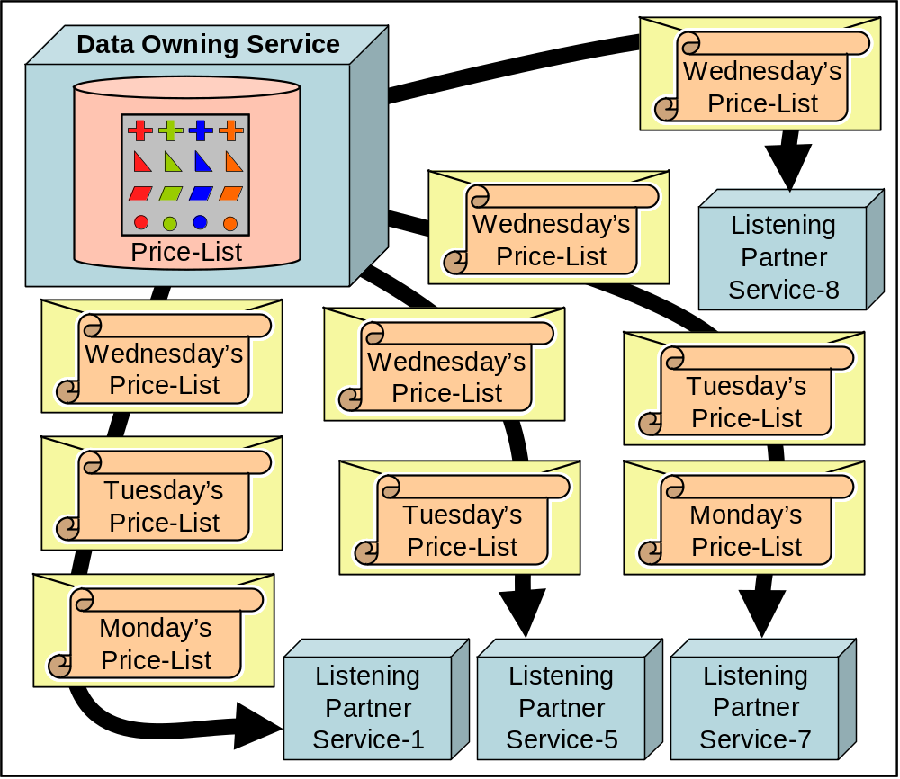
Versioned Images of a Single Source
A Sequence of Versions Describing Changes to Data
  Updates From
  One Service
Owner Controlled
  Owner Changes
  the Data
  Sends Changes
  as Messages
Data Is Seen
As Advancing
Versions

Slide 16
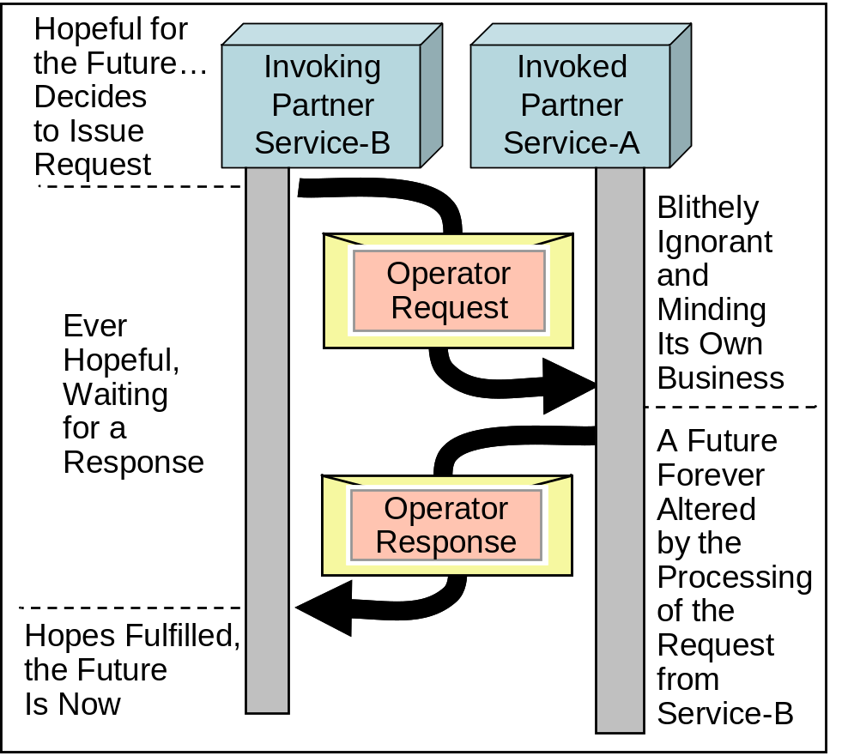
Operators: Hope for the Future
Messages May Contain Operators
  Requests for Business Functionality Part of the Contract
  Service-B Sends an Operator to Service-A
If Service-A Accepts the Operator, It Is Part of Its Future
  It Changes the State of
  Service-A
Service-B Is Hopeful
  It Wants Service-A To Do
  the Work
  When It Receives a Reply,
  It’s Future Is Changed!

Slide 17
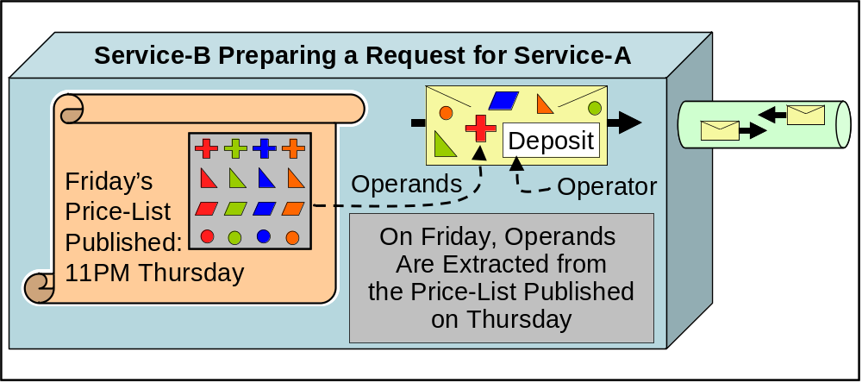
Operands: Past and Future
Operands May Live in the Past
  Values Published As Reference Data
  Come From Service-A’s Past
Operands May Live in the Future
  They May Contain a Proposed Value Submitted to Service-A

Slide 18
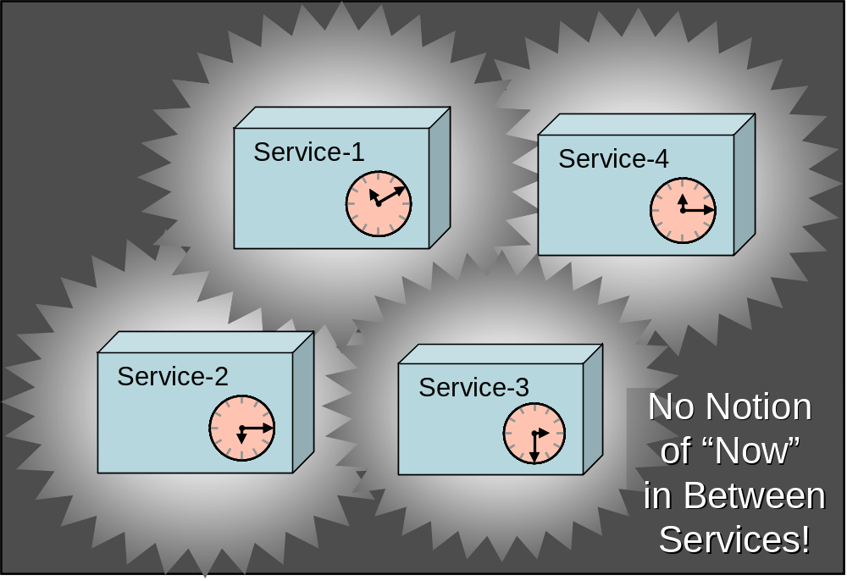
Between Services: Life in the “Then”
Everything Between Services Lives in the Past or Future
  Operators Live in the Future
  Operands Live in the Past or the Future
It’s Not Meaningful to Speak of “Now” Between Services
  No Shared Transactions → No Simultaneity
Life in the “Then”
  Past or Future
  Not Now
Each Service Has
a Separate “Now”
  Different Temporal
  Environments!

Slide 19
Services: Dealing with “Now” and “Then”
Services Make the “Now” Meet the “Then”
  Each Service Lives in Its Own “Now”
  Messages Come and Go Dealing with the “Then”
  The Business-Logic of the Service Must Reconcile This!!
Example: Accepting an Order
A Biz Publishes Daily Prices
Probably Want to Accept
Yesterday’s Prices for a While
Tolerance for Time Differences
Must Be Programmed
Example:
“Usually Ships in 24 Hours”
Order Processing Has Old Info
Available Inventory Not Accurate
Deliberately “Fuzzy”
Allows Both Sides to Cope with
Difference in Time Domains!
The World Is No Longer Flat!
  SOA Is Recognizing That There Is More Than One Computer
  Multiple Machines Mean Multiple Time Domains
  Multiple Time Domains Mandate We Cope with Ambiguity to
  Allow Coexistence, Cooperation, and Joint Work

Slide 20
Outline
Introduction
Data: Then and Now
Data on the Outside
Data on the Inside
Representations of Data
Conclusion

Slide 21
Immutable And/Or Versioned Data
Windows NT4, SP1
The Same Set of Bits
Every Time
Data May Be Immutable
  Once Written, It Is Unchangeable
Immutable Data Needs an ID
  From the ID, Comes the Same Data
  No Matter When, No Matter Where
Versions Are Immutable
  Each New Version Is Identified
  Given the Identifier, the Same Data Comes
Version Independent Identifiers
  Let You Ask for a Recent Version
Recent NY Times
Maybe Today’s,
Maybe Yesterday’s
Version
Independent
New York Times; 1/6/05
Specific Version of the Paper
-- Contents Don’t Change
Latest SP of NT4
Definitely NT4,
Results Vary Over Time
Notes:
Some data is immutable
Once it has been written, it remains unchangeable just like the New York time edition of June 3rd, 1975 is unchangeable
Immutable data is a glop of data with an identifier that will ALWAYS yield the same data
When you retrieve the price-list for Joe’s Internet Bazaar from Thursday, July 3rd, 2003, you get the same pricelist
When you examine the bits of Windows NT4, SP1, you get the same bits
Again, immutability means that, starting with the same identifier you retrieve the same bit-pattern
No matter when you ask and no matter where you ask
Versioning is a technique for grouping unique identifiers
You can ask about the latest SP for Windows NT4
You can ask for a recent edition of the New York Times

Slide 22

Immutability of Messages
Retries are a Fact of Life
  Zero or more delivery semantics
Messages Must Be Immutable
  Retries Must Not See Differences…
  Once It’s Sent, You Can’t Un-send!
Service-A
Once It’s Outside,
It’s Immutable!

Slide 23
Stability Of Data
Immutability Isn’t Enough!
  We Need a Common Understanding
  President Bush → 1990 vs. President Bush → 2005
Stable Data Has a Clearly Understood Meaning
  The Interpretation of Values Must Be Unambiguous
Suggestion
Timestamping or
Versioning Makes
Stable Data
Observation
A Monthly Bank Statement
Is Stable Data
Advice
Don’t Recycle
Customer-IDs
Observation
Anything Called
“Current” Is Not Stable
Notes:
Just because data is immutable doesn’t mean it is always understood the same way!
A reference to President Bush in 2003 means something different than a reference to President Bush made in 1990
Stable data has a meaning that is clearly understood
First, it must have an immutable schema definition
Stable meta-data means that you can clearly understand the schema
Distributed data must be both immutable (perhaps versioned) and stable
You must ensure that the bits are as intended whenever and wherever they may be retrieved
You must ensure that the interpretation of the bits is what is intended for the time-scope and geographic scope of the data’s life

Slide 24
Schema and Immutable Messages
When a Message Is Sent, It Must Be Immutable
  It Is Crossing Temporal Boundaries
  Retries Mustn’t Give Different Results
The Message’s Schema Must Be Immutable
  It Makes a Mess If the Interpretation of the Message Changes
Service-A
Message
Schema Versions Are Immutable
A Message Should Reference
a Specific Version of Its Schema
The Schema Can Then Evolve
Without Invalidating the Schema
for the Existing Messages…
Message
Schema
Immutable Message
Immutable Schema
for the Message

Slide 25
Reference-Based Data, Immutability, and Directed Acyclic Graphs
Messages Must Be Interpreted Correctly Across Time
  Stable Values Are Essential
  References to Other Data Must Be Unambiguous Across Time
Immutable and Stable Contents
  Referenced Structures Can’t Change in Content or Interpretation
  Only Works to Reference Pre-Existing Stuff that Doesn’t Change
Version Independent References
  Can Be Used with Caution
  The Semantics of a Structure with Version Independent References Will Change over Time… Be Careful!
Msg-I
Data
“B”
Data
“D”
Data
“H”
Data
“F”
Data
“A”
Data
“C”
Msg-J
Data
“E”
Data
“G”

Slide 26
DAGs of History
Data
“B1”
Data
“C2.1”
Service-1
Data
“A1.1”
Data
“B2”
Data
“B3”
Data
“A1”
Data
“A2”
Service-2
Data
“D1.1”
Data
“D2.1”
Data
“C1”
Data
“C2”
Data
“C3”
Service-3
Data
“D2”
Data
“D3”
Data
“D1”
Service-4
Data
“D1.2”

Slide 27
Outline
Introduction
Data: Then and Now
Data on the Outside
Data on the Inside
Representations of Data
Conclusion

Slide 28
Storing Incoming Data
When Data Arrives from the Outside, You Store It Inside
  Most Services Keep Incoming Data
    Keep for Processing
    Keep for Auditing
Inside Data
Incoming
Data

Slide 29
SQL, DDL, and Serializability
SQL’s DDL (Data Definition Language) is Transactional
  Changes Are Made Using Transactions
  The Structure of the Data May Be Changed
    The Interpretation After the DDL Change Is Different
DDL Lives Within the Time Scope of the Database
  The Database’s Shape Evolves Over Time
  DDL Is the Change Agent for This Evolution
SQL Lives in the “Now”
  Each Transaction’s Execution Is Meaningful Only Within the Schema Definition at the Moment of Its Execution
  Serializability Makes This Crisp and Well-Defined

Slide 30
Extensibility versus Shredding
Shredding the Message
  The Incoming Data Is Broken Down to Relational Form
  Empowers Query and Business Intelligence
  Auditing Considerations
    Typically, Don’t Want to Change the Message Image
    Preserve for Auditing
    May Keep Unshredded Version Also for Non-Repudiation
Extensibility
  The Sender Added Stuff You Didn’t Expect
  May or May Not Know How Utilize Extensions
Extensibility Fights Shredding!
  Hard To Map Extensions To Planned Relational Tables
  OK To Partially Shred
    Yields Partial Query Benefits

Slide 31
Encapsulation of Inside Data
Inside Data Is Encapsulated Behind the Business Logic of the Service
  Access To the Data Can Be Through the Logic
  Occasionally, Subsets of the Inside Data Are Filtered and Shipped Outside
Inside Data

Slide 32
Outline
Introduction
Data: Then and Now
Data on the Outside
Data on the Inside
Representations of Data
Conclusion

Slide 33

XML, SQL, and Objects
XML
  Schematized Representation of Messages
  Hierarchical Structure
  Schema Supports Independent Definition and Extensibility
SQL
  Stores Relational Data by Value
  Allows You to “Relate” Fields by Values
  Incredibly Query Capabilities
  Rectangular Representation
Objects
  Very Powerful Software Engineering Tool
  Based on Encapsulation
Data
SQL

Slide 34
Bounded And Unbounded
Data Representations
Relational Is Bounded
  Operations Within the Database
  Value Comparisons Only Meaningful Inside
  Tightly Managed Schema
XML-Infoset Is Unbounded
  Open (Extensible) Schema
    Contributions to Schema from
    Who-Knows-Where
  References (Not Just Values)
    URIs Known to Be Unique
  XML-Infosets Can Be Interpreted Anywhere
Notes:
Relational is a bounded representation of data
Contained within a Database
Definitions in the database are only meaningful in the fullness of the database
Can do complex joins across anything within the bounded database
This is easier when the “universe” is contained
Not meaningful to reference data outside the database
The contents of the database itself are not cleanly understandable outside of the local system (without additional description)
XML-Infosets are an unbounded representation
Everything is tagged with a namespace
The schema is globally identified
References are via URIs
They are meaningful anywhere
XML-Infosets can be interpreted anywhere
The semantic is designed to be understood everywhere

Slide 35
Encapsulation and Anti-Encapsulation
SQL Is Anti-Encapsulated
  UPDATE WHERE
    Query/Update by Joining Anything with Anything
  Triggers/Stored-Procs Are Not Strongly Tied to Protected Data
XML Is Anti-Encapsulated
  Please Examine My Public Schema!
Components/Objects Offer Encapsulation
  Long Tradition of Cheating:
    Reference Passing to Shared Objects
    Whacking on Shared Database

Slide 36
A Service’s View of Encapsulation
Anti-Encapsulation Is OK in Its Place
  SQL’s Anti-Encapsulation Is Only Seen by the Local Biz-Logic
  XML’s Anti-Encapsulation Only Applies to the “Public” Behavior and Data of the Service
Encapsulation Is Strongly Enforced by the Service
  No Visibility Is Allowed to the Internals of the Service!
The Service
Is a
Black Box!
Sanitized Data
for Export
Data
Exported Data
Private
Internal
Data
Business Request

Slide 37
What About Persistent Objects?
Persistent Objects
  Encapsulated by Logic
  Kept in SQL
  Uses Optimistic Concurrency (Low Update)
Stored as Collection of Records
  May Use Records in Many Tables
  Keys of Records Prefixed with Unique ID
    This is the Object ID
Encapsulation by Convention
  Encapsulation Broken
  by Business Intelligence
Table-B
ID-X
<key1>
<record>
ID-X
<key2>
<record>
ID-X
<key3>
<record>
ID-Y
<key1>
<record>
SQL
ID-Y
<key2>
<record>
Table-A
Database-Key
ID-X
<key>
<record>
ID-Y
<key>
<record>
ID-Z
<key>
<record>
Persistent Object
ID=Y
Database-Key
Notes:
Sometimes people implement persistent objects
These are kept in the SQL database
They are pulled into memory on demand, worked on through a transaction, and stuffed back into SQL on completion
Typically, optimistic concurrency control is used
Rather than lock the data, the in-memory object remembers all the details of what was read from the database
When the object changes are completed, the database is checked to ensure no one has fiddled with the contents
If no changes have happened, the updates are made to the SQL copy
Persistent objects are implemented as a collection of records in a collection of tables
The structure of the persistent object in its database storage may be quite rich and complex
The persistent object is identified by a unique key
Requests to work with this object must supply the key value
The key value is the equivalent of an object reference and may be stored in other objects as a persistent reference
All the records for a single persistent object are indexed by this key
The key is the prefix of the actual primary key used for the record in SQL
Each object is a slice across a set of tables in SQL
Many objects live in the set of tables
The usage pattern for these objects ensures that the set of records is never updated except through the object code
The collection of records across tables is an intact object

Slide 38
Characteristics of Inside versus Outside
Inside Data
Outside Data
Temporal
Nature
NOW
THEN
Schema
Definition
Tightly Defined:
within DB Bounds;
within a Transaction
Independent Definition
------
Compose-able from
Independent Pieces
Need for
Encapsulation
Encapsulation at the
Service Boundary;
------
Services Are Big So We
Need Objects Inside ‘Em
Just Data
------
No Behavior
Updateability
Classic DB Stuff
------
Assume We Need
Normalization
Write Once
------
Read Many
Queryability
Classic DB Stuff
Must Integrate Schemas
------
What Are Cross-Schema
Semantics?

Slide 39
Today’s Ruling Triumvirate
SQL
It is fantastic to compare anything to anything and combine
anything with anything in Relational (within the bounded database)
XML
It is possible to have independent definition of schema and data in
XML-Infosets. You can independently extend, too.
Components/
Objects
Provide encapsulation of data behind logic. Ensure enforcement of
business rules. Eases composition of logic.
Strengths and
Weaknesses
Arbitrary
Queries
Independent
Data Definition
Encapsulation
(Controls Data)
SQL
Bounded Schema
Outstanding
Impossible:
Centralized Schema
Not via SQL
Enforced by DBA
XML
Unbounded Schema
Problematic:
Schema inconsistency
Outstanding
Impossible:
Open Schema
Objects
Encapsulated Data
Impossible:
Can’t see the data!
Impossible
Can’t see the data!
Outstanding
Each model’s strength is simultaneously its weakness!
You can’t enhance one to add features of the other without breaking it!
Footnote: Arguably, SQL constrains the data semantics to avoid problems and
XML is a superset allowing the flexibility to get into problems SQL avoids.

Slide 40
Outline
Introduction
Data: Then and Now
Data on the Outside
Data on the Inside
Representations of Data
Conclusion

Slide 41
Putting It All Together!
Today, Services Need All Three!
  XML-Infosets: Between the Services
  Objects: Implementing the Business Logic
  SQL: Storing Private Data and Messages
Data
SQL
XML-InfoSets for
Messages Between Services
Objects Implement
the Biz Logic
SQL Holds
the Data
Notes:
Implementing a service requires:
XML-Infosets for communication between services
Objects/Components for implementing the business logic
SQL for storing the mission-critical data encapsulated by the service (both Resource and Activity) and the messages (both incoming and outgoing)

Slide 42
Data Inside and Outside Services
Data Is Different Inside from Outside
Outside the Service
  Passed in Messages
  Understood by Sender and Receiver
  Independent Schema Definition Important
  Extensibility Important
Inside the Service
  Private to Service
  Encapsulated by
  Service Code
MSG
Data
SQL
MSG
Data Outside
the Service
Data Inside
the Service
Notes:
Data lives either:
Outside services
Passed in messages
Must be understood by both:
The service creating the “inter-service-data”, and
The service reading and using the “inter-service-data”
Inside a single service
Private to the service and only accessed via encapsulating code
May be a replica of some data that lives outside services
The characteristics of the “inside” data differ from the “outside” data
Inside, you need tightly organized schema associated with you application code
You may want to apply business intelligence to it
You may need to adjust your schema for semantic changes or for optimization of your application’s database access
Outside, you need to optimize for flexibility, extensibility, and mutual understanding across systems
This should tolerate changes across time and the evolution of the participating services

Slide 43
Resources
http://msdn.microsoft.com/architecture
www.PatHelland.com
http://blogs.msdn.com/PatHelland

